Slide 1
.NET Community Events
Presented on September, 2019

Slide 2
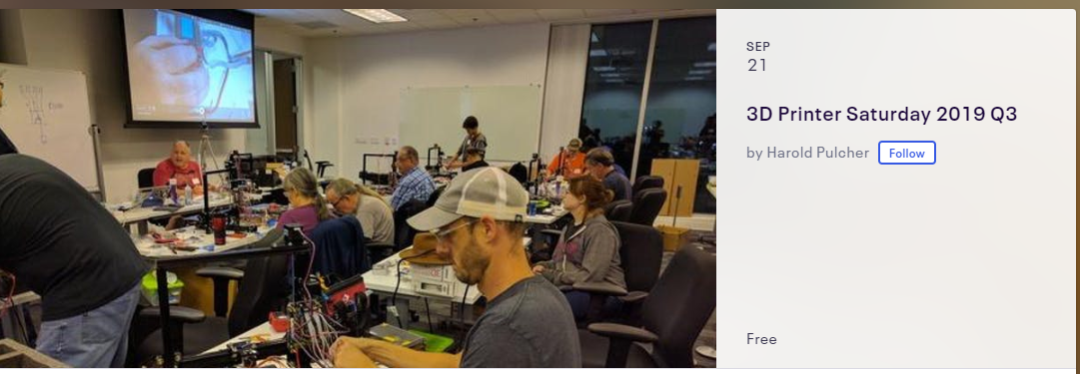
Announcements
https://www.eventbrite.com/e/3d-printer-saturday-2019-q3-tickets-71570259573

Slide 3
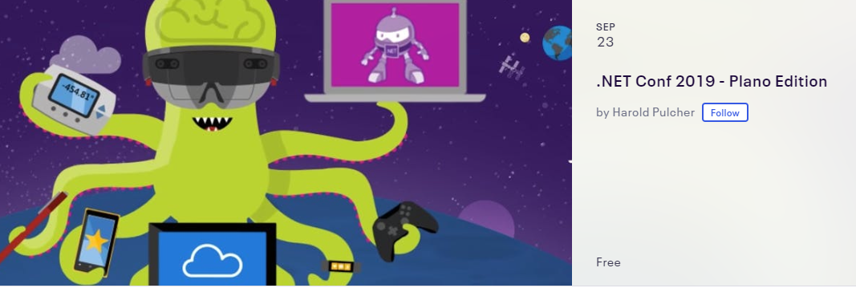
Announcements
https://www.dotnetconf.net/
https://www.eventbrite.com/e/net-conf-2019-plano-edition-tickets-70328661921

Slide 4
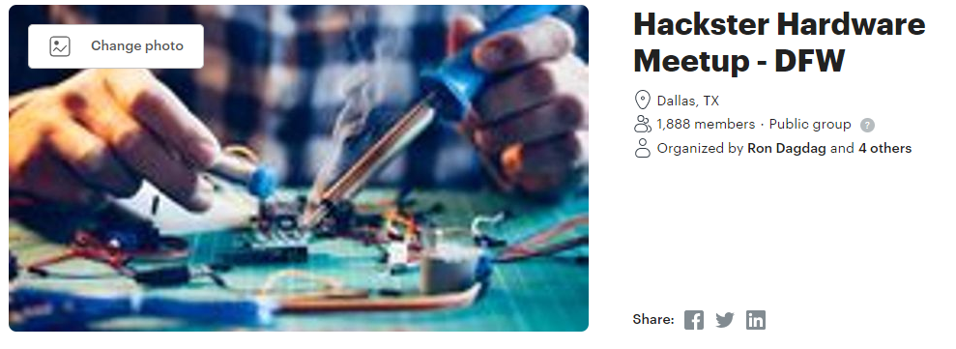
Announcements
https://www.meetup.com/Hackster-DFW/

Slide 5

Announcements
https://globalai.community/global-ai-bootcamp/

Slide 6
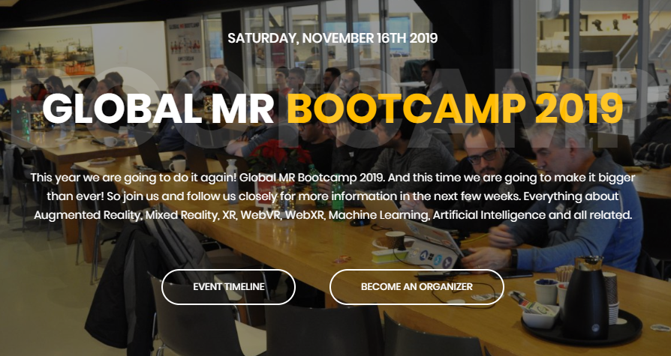
Announcements
https://www.globalmrbootcamp.com/event/tmp-2/

Slide 7

DevFestWeekend 2020 – Call for Volunteers
Https://bit.ly/DevFestWeekend2 (case sensitive) to signup for leaders & volunteers

